Slide 1
Front End Engineering-I Project
Team Details: Team No. 24
Team Members :1) Divyanshu(2310990244)
2) Dollsy Rani(2310990245)
3)Gagan Pahwa(2310990247)
Faculty Coordinator: Dr. Amandeep Kaur
:
Chitkara University Institute of Engineering and Technology,
Chitkara University, Punjab

Slide 2
Table of Contents
Introduction
Problem Statement
Technical Details
Key Features
Project Highlights
Conclusion
References/Links used

Slide 3
Introduction
INDIAN AUCTION COMPANY
Team Members:
Divyanshu
Dollsy Rani
Gagan Pahwa
Project Overview: INDIAN AUCTION COMPANY project aims to create a user-friendly online platform for conducting auctions. This platform will enable users to buy and sell a wide range of items, from collectibles to real estate, in a convenient and secure online environment.
Goals:
Enhance User Experience
Trust And Security
Wide Range of Categories
Quality Assurance

Slide 4
Problem Statement
The Problem Is To Create A User Friendly online auction platform that overcomes these challenges and offers a safe, diverse, and seamless auction experience. Our research indicates a clear demand for a solution that enhances trust, usability, and convenience for both buyers and sellers in the online auction ecosystem.
Some Major Problems:
Trust and Security Concerns: Many users are hesitant to participate in online auctions due to concerns about fraud, counterfeit items, and payment security.
Lack of User-Friendly Platforms: Existing auction platforms can be complex and difficult to navigate, leading to a frustrating user experience.
Limited Category Diversity: Some platforms focus on specific niches, limiting the choices available to users.
Inefficient Bidding and Payment Systems: Slow or unreliable bidding processes and payment methods can deter users from participating in auctions.
Inadequate Mobile Accessibility: With the growing use of mobile devices, a lack of mobile-friendly platforms hinders user engagement.
Limited Data Insights: Users often lack access to detailed analytics and reporting tools to make informed decisions.

Slide 5

Technical Details
Here We used:
HTML : Hyper Text Markup Language.
CSS : Cascading Style Sheets.
By combining HTML, CSS and Javascript.We Completed Our Project i.e. Online Auction Platform.

Slide 6
Key Features
User Registration and Authentication
Auction Listings
Bidding and Auction Management
Payment Processing
Search and Filter Options
User Ratings and Reviews
Security Measures
Terms and Conditions
Customer Support
Analytics and Reports

Slide 7
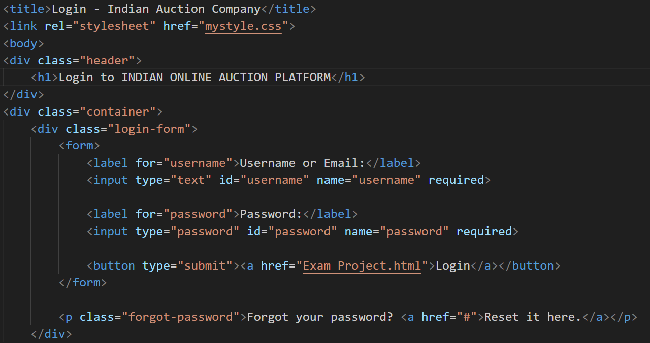
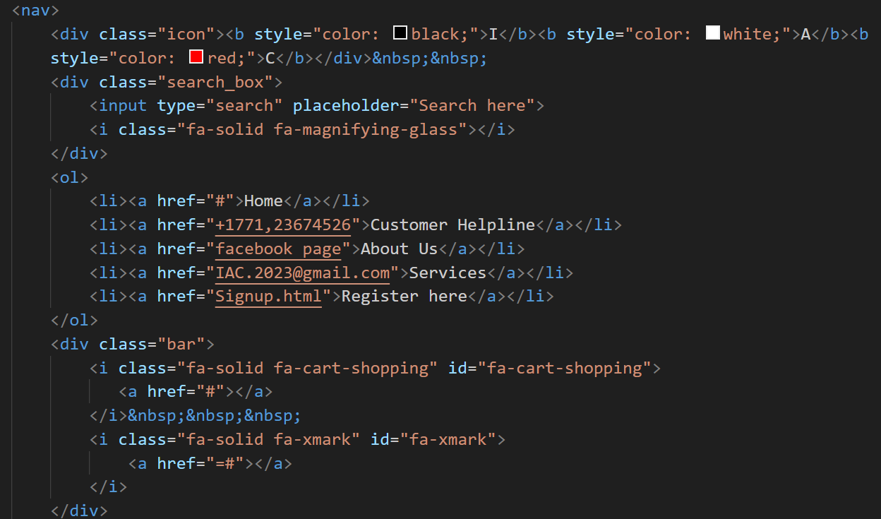
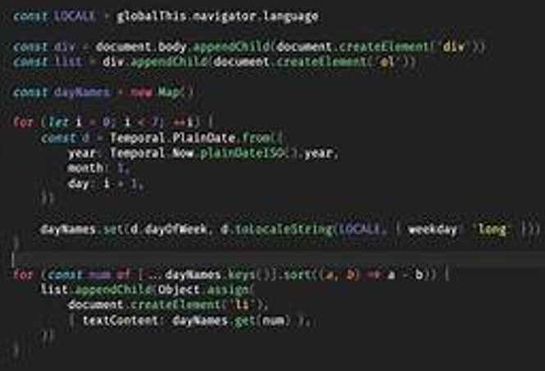
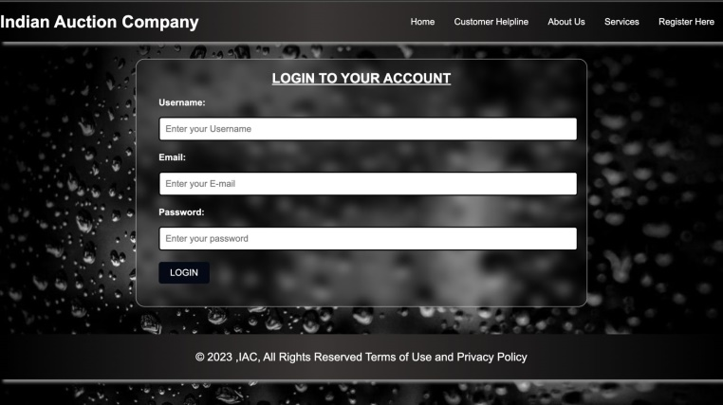
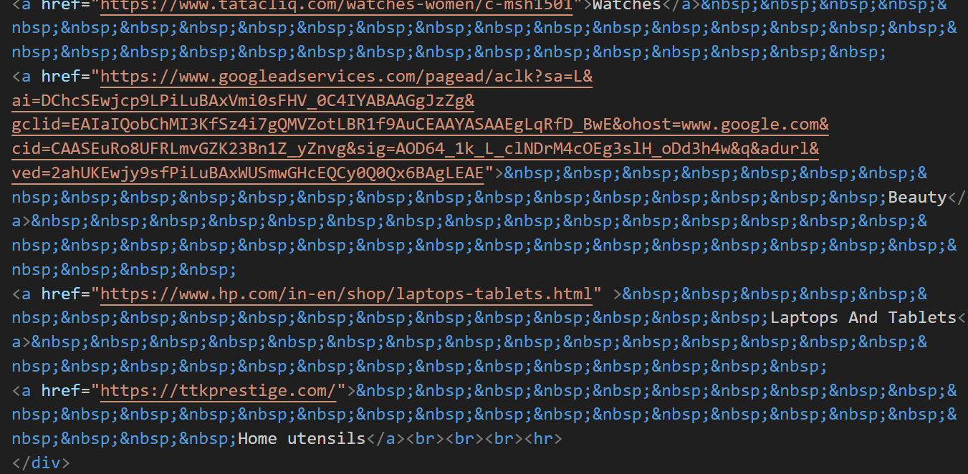
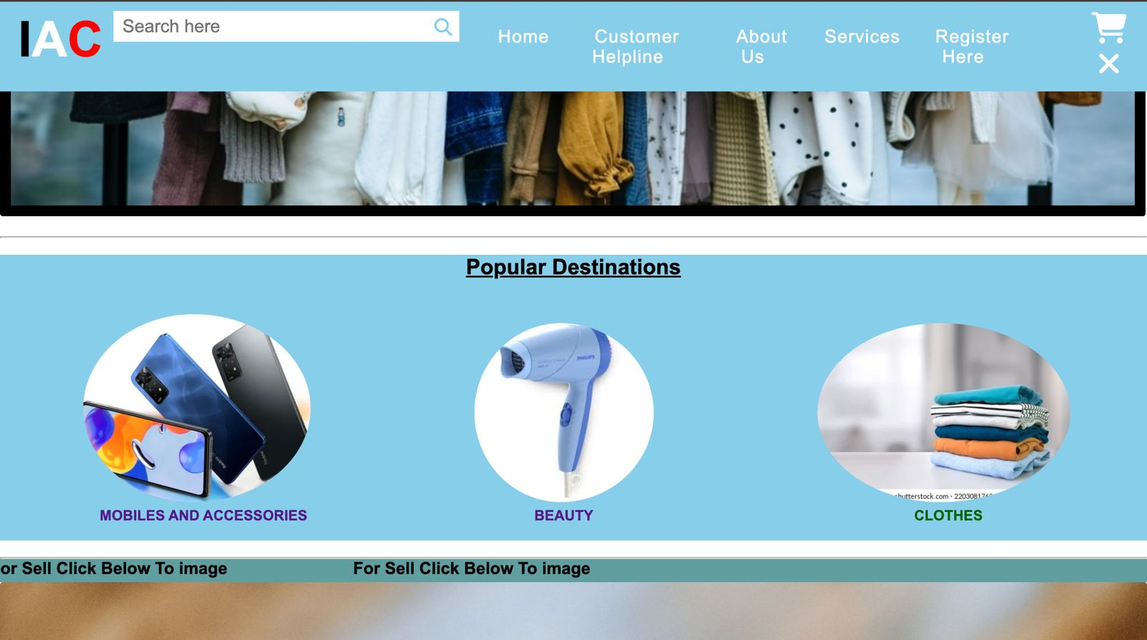
Project Highlights

Slide 8
Conclusion
Project Objective: Our goal was to create a robust online auction platform that offers a seamless and secure experience for buyers and sellers.
Feature Development: We successfully implemented essential features such as user registration, auction listings, bidding, payment processing, and more.
User-Centered Design: The platform's user interface was designed with a focus on user experience, ensuring ease of use and accessibility.
Security Measures: Robust security features were put in place, including encryption, fraud prevention, and user authentication.
Data Analytics: The incorporation of data analytics provided valuable insights into user behavior and market trends.
Scalability: Our infrastructure and load balancing ensured the platform's performance even during peak traffic.
Legal Compliance: The platform adhered to relevant local and Country laws, including tax regulations.

Slide 9
References/Links used
AuctioNet. (2023). Welcome to AuctioNet - Your Online Auction Platform. https://www.auctionet.com
We used AuctioNet for idea of our Project.
2. W3Schools. "HTML and CSS Documentation". W3Schools, Geeks for geeks.
We referenced this website extensively for HTML and CSS syntax and best practices.
Internal Team Knowledge. "Project Management and Assistance." Team 24 B.E 23
Our internal knowledge and Assistance played a significant role in project Success.

Slide 10


